Slide 1
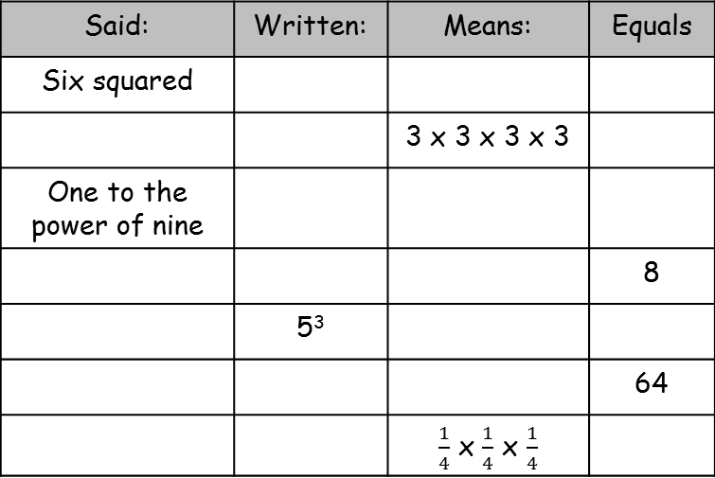
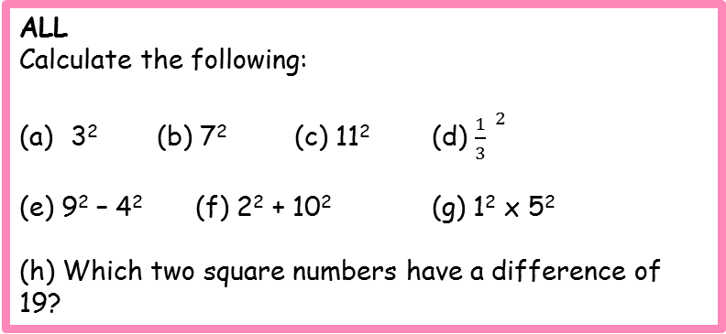

Powers
ALL
Calculate the following:
3² (b) 7² (c) 11² (d) ${\frac{1}{3}}^{ 2}$
(e) 9² – 4² (f) 2² + 10² (g) 1² x 5²
(h) Which two square numbers have a difference of 19?
SOME:
1. Use the clues to work out the value of the numbers A, B, C, D, E and F:
2. The problem: You know that 10 x 10 ( or 10² ) = 100
(a) Calculate 9 x 11 ?
What do you notice?
(b) Calculate the following. What do you notice? Why is this?
20² and 19x21
50² and 49x51
100² and 99 x 101
3. When you add the square of Ben’s age to Ali’s you get 53. When you add the cube of Ali’s age to Ben’s you get 71. How old are Ali and Ben?
4. Create your own version of the puzzles in question 1 for letters A to J. How many different powers can you use?
A = $2^{2}$
D - 2 =B³
F = B^{A}
C = A³ - 59
2E = F
F = A^{B}
MOST
Copy and complete the following table:
Said: | Written: | Means: | Equals
Six squared
 |  | 3 x 3 x 3 x 3
One to the power of nine
 |  |  | 8
 | 5³
 |  |  | 64
 |  | $\frac{1}{4}$ x $\frac{1}{4}$ x $\frac{1}{4}$

Slide 2
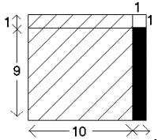
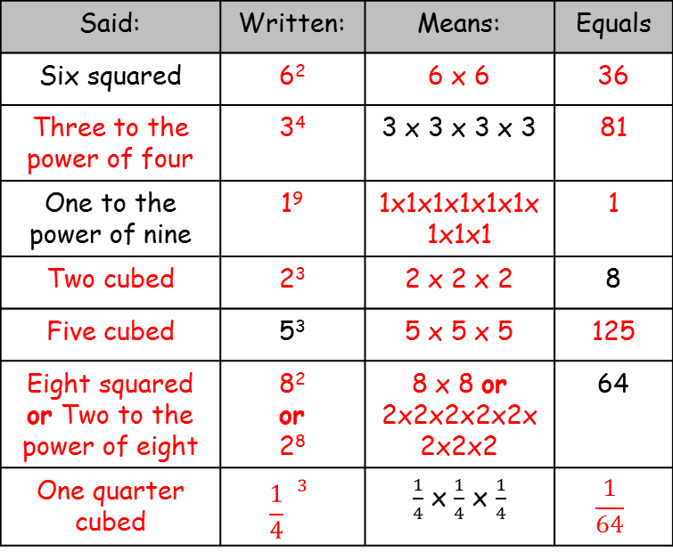
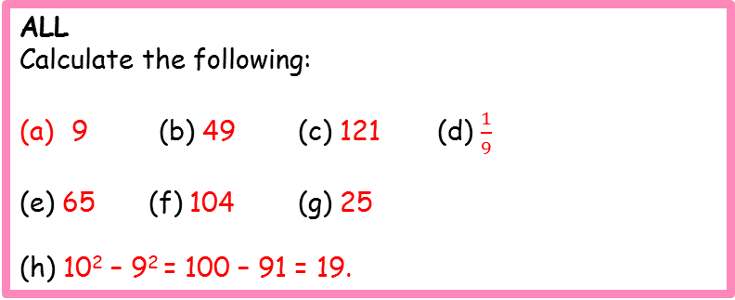
Powers - answers
ALL
Calculate the following:
9 (b) 49 (c) 121 (d) ${\frac{1}{9}}^{ }$
(e) 65 (f) 104 (g) 25
(h) 10² – 9² = 100 – 91 = 19.
SOME:
1. Use the clues to work out the value of the numbers A, B, C, D, E and F:
A = 4
B = 2
C = 5
D = 10
E = 8
F = 16
2.
3. Ali is 4, Ben is 7.
4. Create your own version of the puzzles in question 1 for letters A to J. How many different powers can you use?
MOST
Copy and complete the following table:
Example: 9 x 11 = 10² - 1²
Said: | Written: | Means: | Equals
Six squared | 6² | 6 x 6 | 36
Three to the power of four | 3⁴ | 3 x 3 x 3 x 3 | 81
One to the power of nine | 1⁹ | 1x1x1x1x1x1x1x1x1 | 1
Two cubed | 2³ | 2 x 2 x 2 | 8
Five cubed | 5³ | 5 x 5 x 5 | 125
Eight squared or Two to the power of eight | 8² or 2⁸ | 8 x 8 or 2x2x2x2x2x2x2x2 | 64
One quarter cubed | $${\frac{1}{4}}^{ 3}$$ | $\frac{1}{4}$ x $\frac{1}{4}$ x $\frac{1}{4}$ | $$\frac{1}{64}$$

